Slide 2
Software Engineering Tools:
Diagnosing API issues an monitoring API performance

Slide 3

Computer Science Graduate from Brunel University
Working in the Ecommerce domain with team Pixar (product & sizing platform)
Previously completed an internship at AXA Investment Managers

Slide 4
Why are these tools useful?

Slide 5
Here are a few!
Identify API failures that might have been missed by automated feedback loops?
See exactly what data is being sent between whom?
Manually check that your API’s endpoints have the expected behaviour.

Slide 6

HTTP Requests

Slide 7
Types of Requests
GET- the ‘getting’ request type, used to request data from an API. (normally returns this data in the response body)
POST- the ‘sending’ request type, used to send data to an endpoint of a webservice for consumption. The data type you are sending is defined in the request header and the data itself in the request body.
DELETE- the ‘disposal’ request type, used to delete data from an endpoint or service.

Slide 8
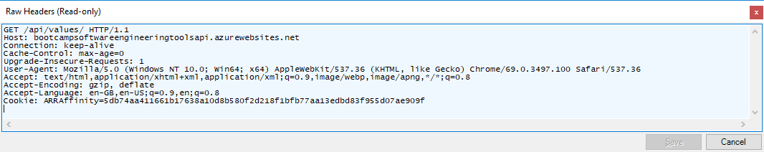
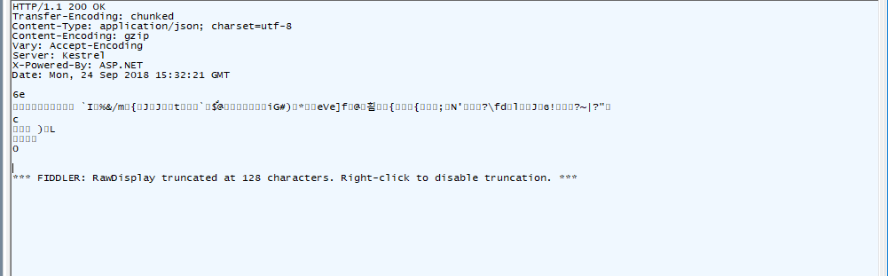
Standard GET request example

Slide 9
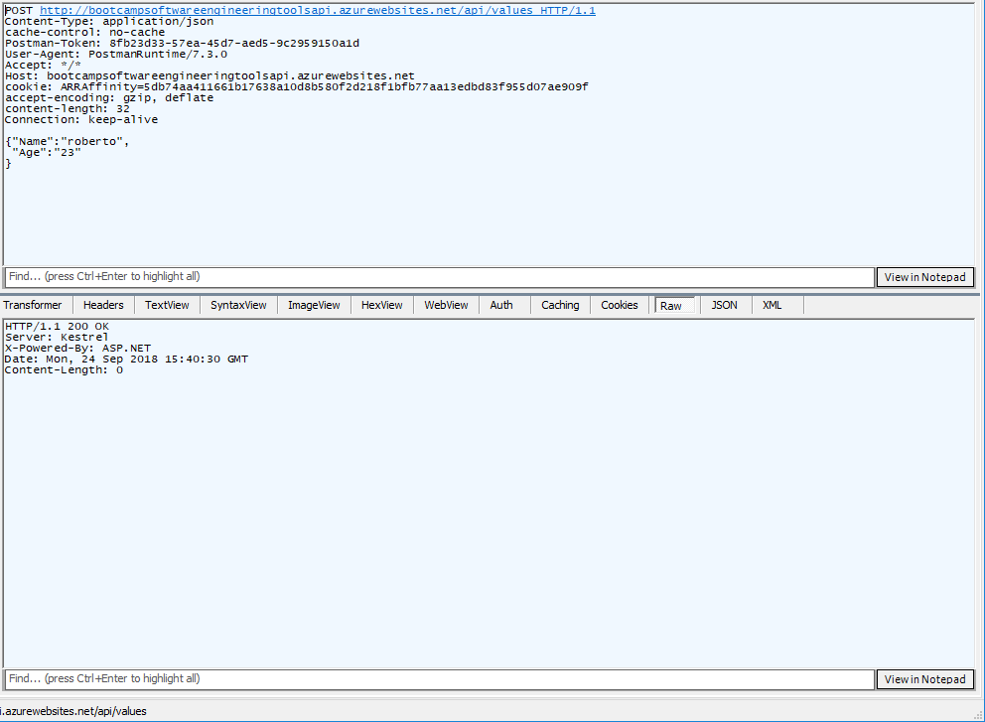
Standard POST request example

Slide 10
Packet Sniffers
Programs which intercept web requests and responses being sent a received on a device.
These allow you to see HTTP requests to data sources that are used to populate web pages.
Charles proxy, Fiddler, Wireshark etc.

Slide 11
Demo Time

Slide 12

Mocking API Calls

Slide 13
Request Composers
Programs which can be used to compose and send HTTP requests of different types to web services.
These allow you send to trigger responses from web API endpoints.
Postman, Fiddler, etc.

Slide 14
Demo Time

Slide 15

Performance Monitoring

Slide 16
Why do we want to monitor performance?

Slide 17
Performance Monitors
Monitor consistent behaviour and speeds in requests and responses.
Alerts can be set with different threshold values.
Can be used in combination with performance load tests to prove the resilience of a system during periods of peak load.
Speed is essential to the business!

Slide 18
Demo Time

Slide 19
Summary
There are many tools that can be used to troubleshoot and monitor our APIs.
Some are manual and can be triggered by you
Some are automated and can be used to “watch” our services in the background.
Logging can be generic using default instrumentation tools, or specific and event based using traces.

Slide 20

Demo Time

